Slide 1
Electropneumatic Systems Mrs. Meera Ajit Khandekar Department of Instrumentation & Control College of Engineering, Pune

Slide 2
Outline
Pneumatic Components
Actuations Means
PLC Hardware
Application
Logic Implementation

Slide 3
Actuation Means: Manual Mechanical Electrical Direction Control Valves: 3/2 DCV, 5/2 DCV, 4/2 DCV Special Purpose Valves: Pressure regulator, pressure relief valves, Pressure sequencing valve, time-delay valve, flow control valve, two-pressure valve

Slide 4
Directional air control valves are the building blocks of pneumatic control system.
Symbols show the methods of actuation, the number of positions, the flow paths and the number of ports.
Pneumatic symbols have been standardised in ISO 1219-1:2006. (Fluid power systems and components - Graphic symbols and circuit diagram)

Slide 5
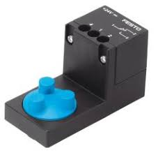
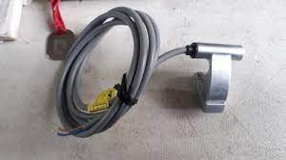
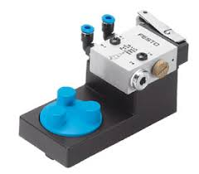
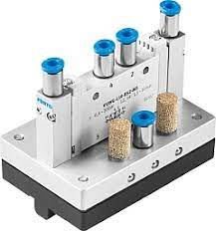

Slide 6
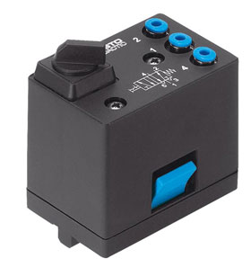
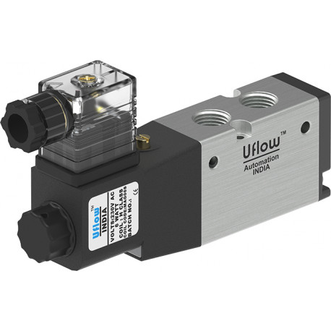
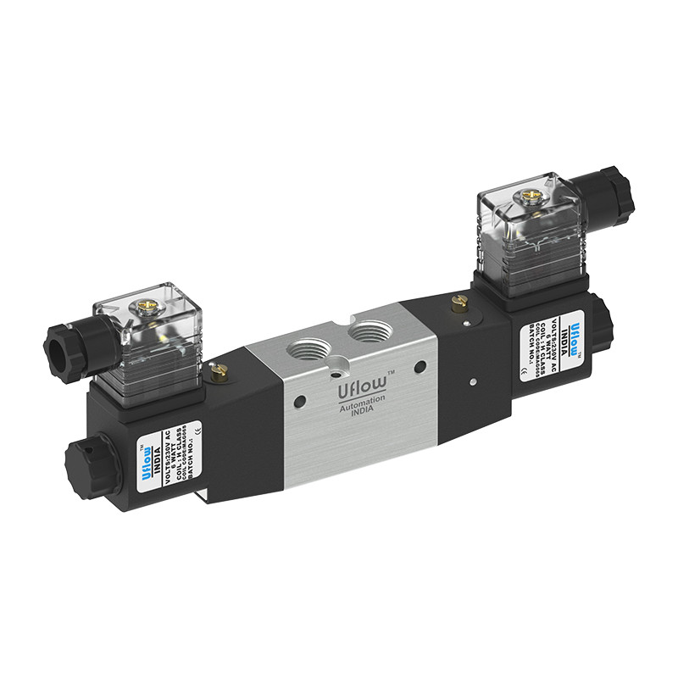
Components…………

Slide 7
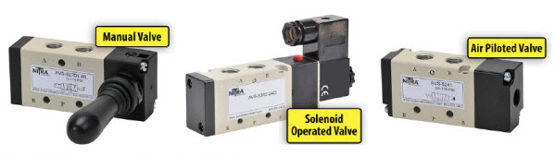

Slide 8
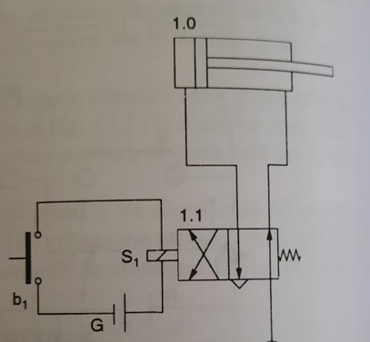
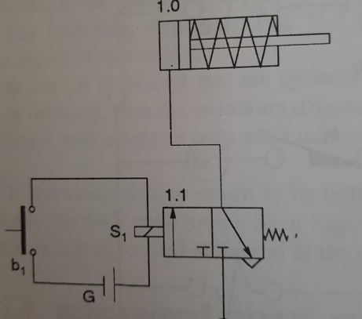
Electropneumatic circuit for cylinders:

Slide 9
PLC Hardware: Control Logix 5560 I/O configuration 1756-CNBR/D ControlNet Bridge 1788-CN2DN Linking Device 1794-ACNR15 adapter 1794-IB16/A 1794-OB16/A

Slide 10
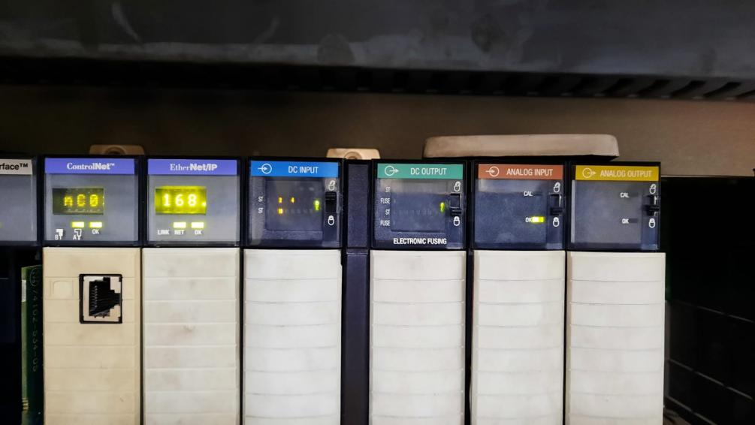

Slide 11
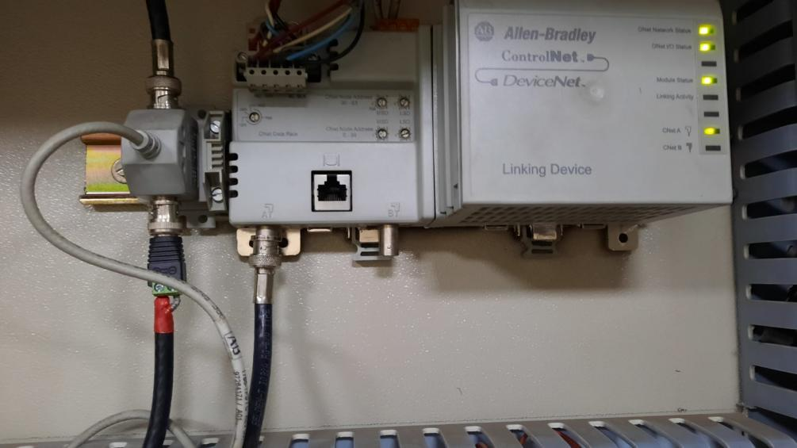

Slide 12
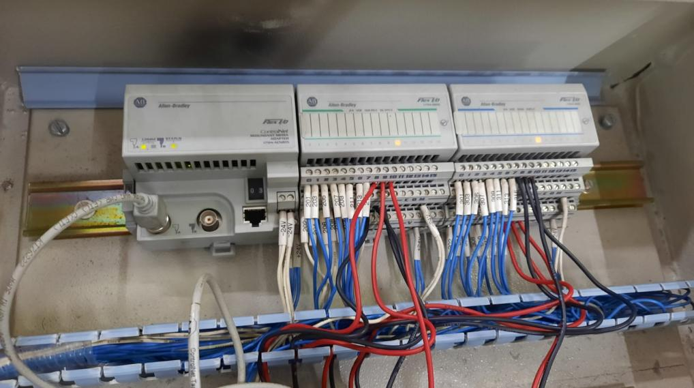

Slide 13
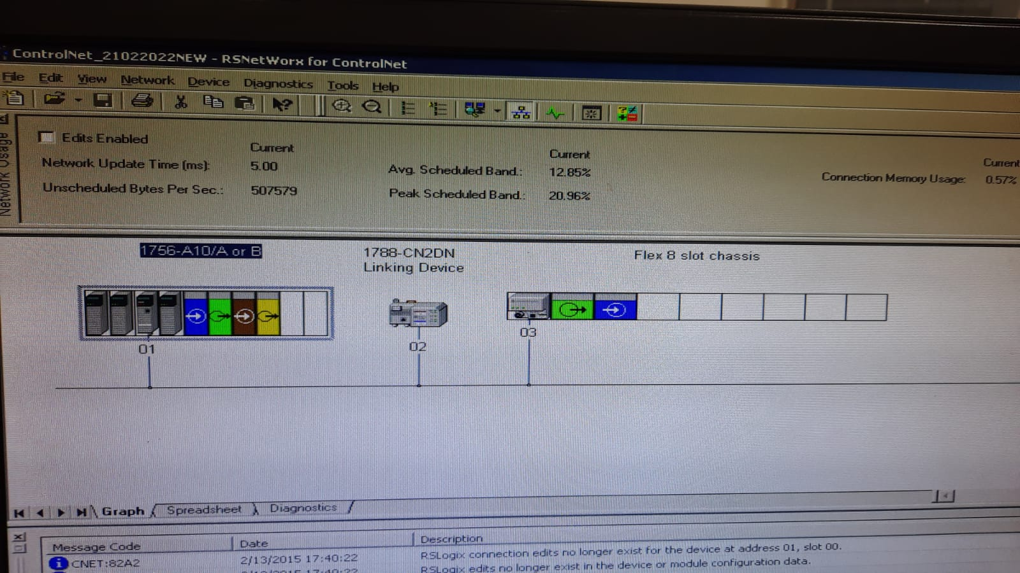

Slide 14
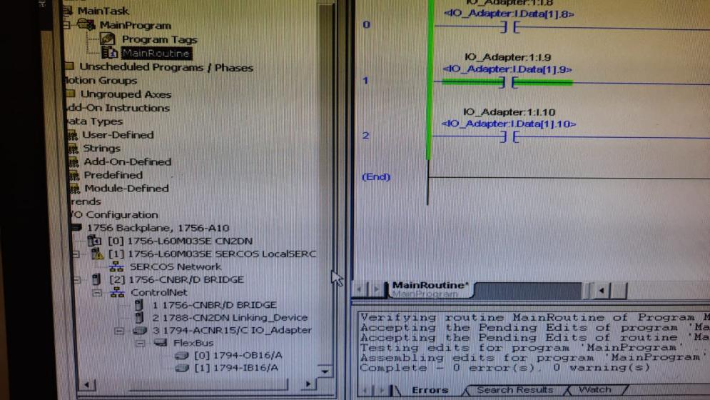

Slide 15
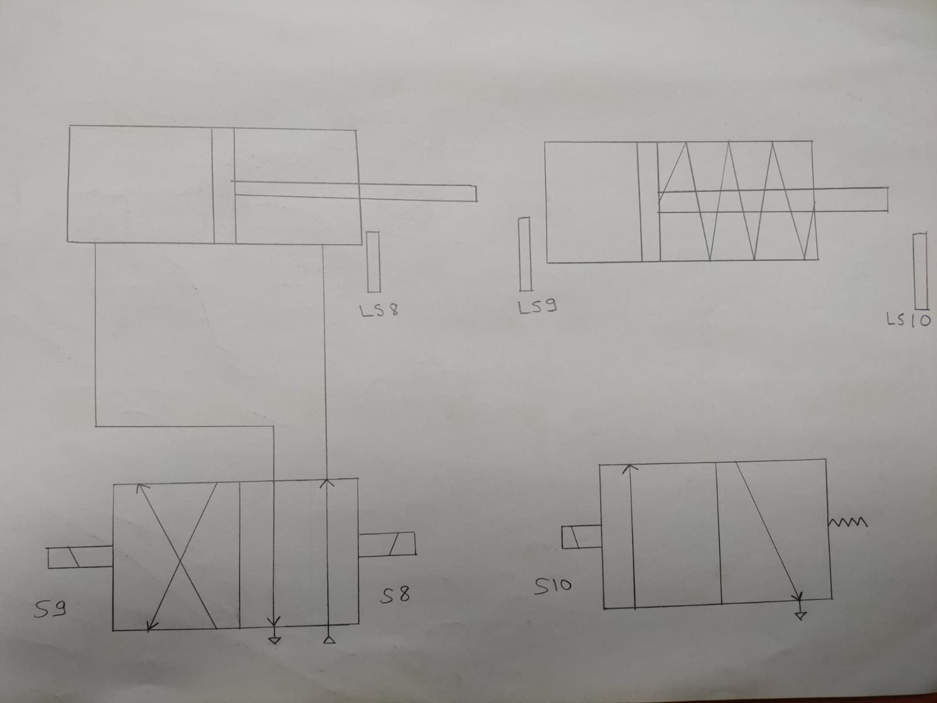

Slide 16
Components Cylinder 1 Double acting cylinder Cylinder 2 single acting cylinder Inputs: Limit switch 1-DI8 Limit switch 2-DI9 Limit switch 3-DI10 Outputs: Solenoid coil –DO9 Solenoid coil-DO10 Solenoid coil-DO11

Slide 17
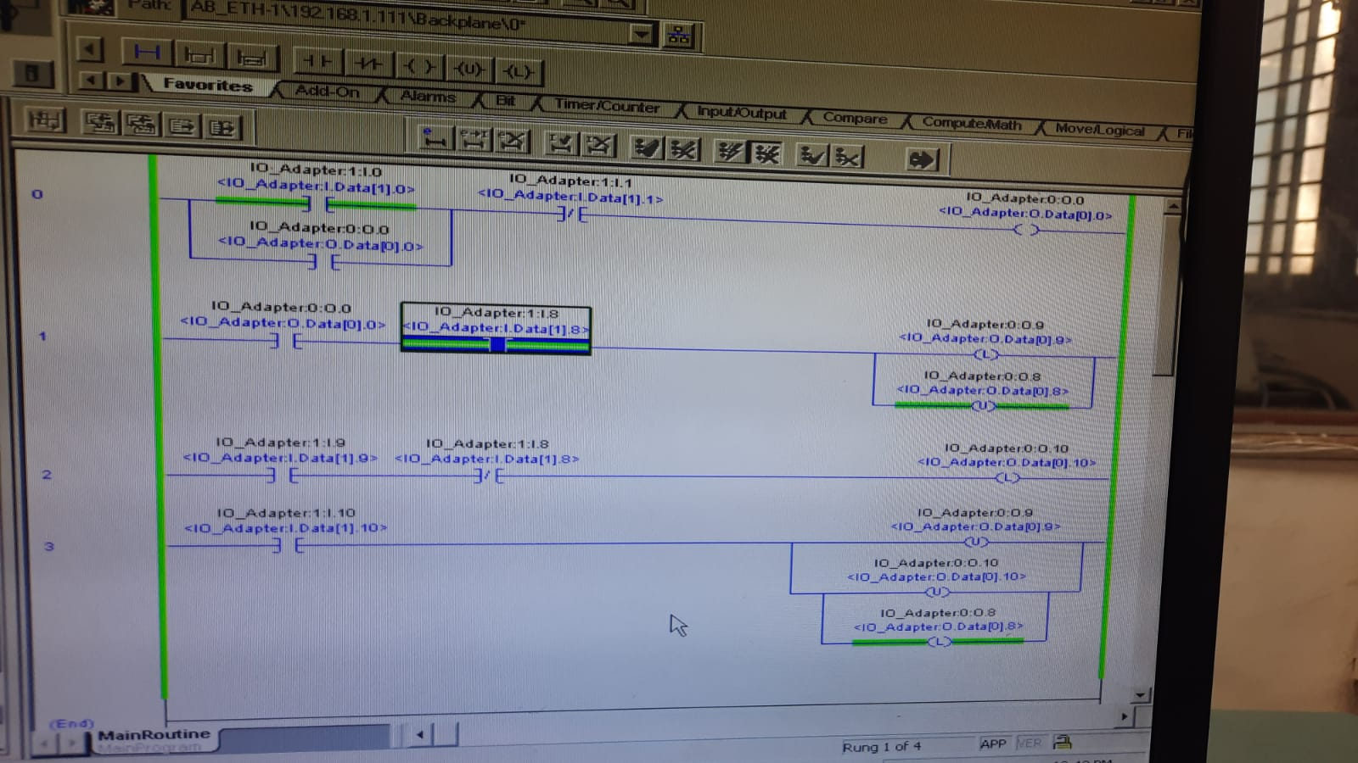
Logic Implementation

Slide 18
Thank You!!!

